Slide 1

CVPR
Dr Ad Spiers (PR), Prof Krystian Mikolajczyk (CV), Dr Abd Al Rahman M Abu Ebayyeh (CVPR)

Slide 2
Goal
To introduce the fundamental concepts, theories and algorithms in computer vision and pattern recognition with applications in robotics.
To give an opportunity to do a practical project in CV & PR
Part of a course on machine learning and related topics

Slide 3
Pre-requisites
Mathematical tools:
Linear algebra,
(Vector) calculus,
Geometry,
Probability
Software
Matlab
Python
OpenCV
Reading/watching
Lecture slides on Blackboard and videos on Panopto
Questions
Ed Forum / Blackboard

Slide 4
Books (Optional)
Pattern Classification, Duda & Hart & Stork
Easy to find pdfs online
Computer Vision: Algorithms and Applications, R. Szeliski.
https://szeliski.org/Book/

Slide 5
Assessment
5 weeks – Pattern Recognition
5 weeks – Computer Vision
One coursework for each, to be done in pairs
PR Deadline – 15th February at 23:59
CV Deadline – 21st March at 23:59
Wiseflow test (Closed Book, in person) – 15th March

Slide 6
PR Lectures (Dr Ad Spiers)
Dimensionality Reduction, Principle Component Analysis (PCA)
Linear discriminant functions, Discriminant Analysis
Data representation, Distances Metrics, Clustering algorithms
Bagging and boosting, Ensemble Learning, Committee Machine
Sequential (Time Series) Data Analysis

Slide 7
CV Lectures (Prof Krystian Mikolajczyk)
Camera model
Image geometry
Stereo vision
Model fitting
Object Classification, Detection, and Segmentation

Slide 8

Pattern Recognition
ELEC97112/ELEC97113
ELEC97112/ELEC97113 – Computer Vision & Pattern Recognition - K. Mikolajczyk & A. Spiers
Dr Ad Spiers

Slide 9
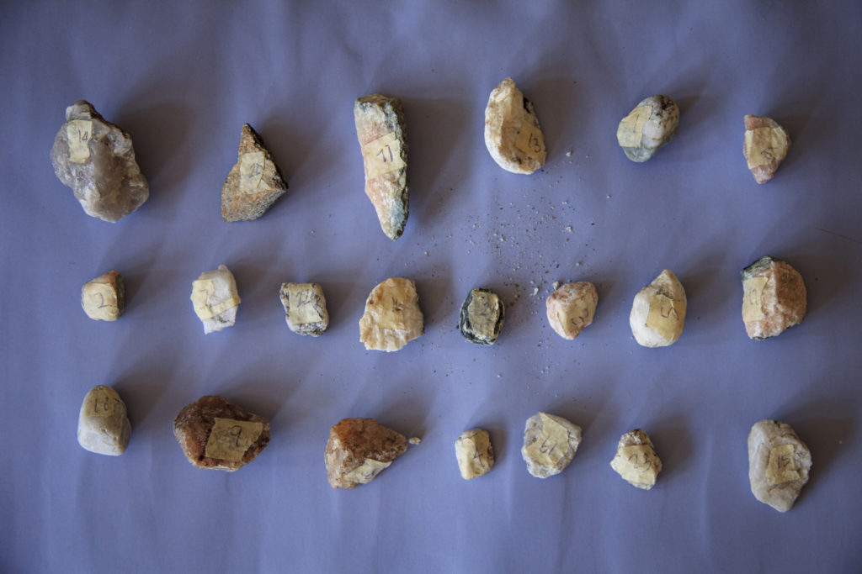
Pattern Recognition
Patterns - Discernible Regularity or Similarity in the World
Pattern Recognition - Process of automatically finding patterns in data
An archaeologist recognises patterns in objects properties

Slide 10
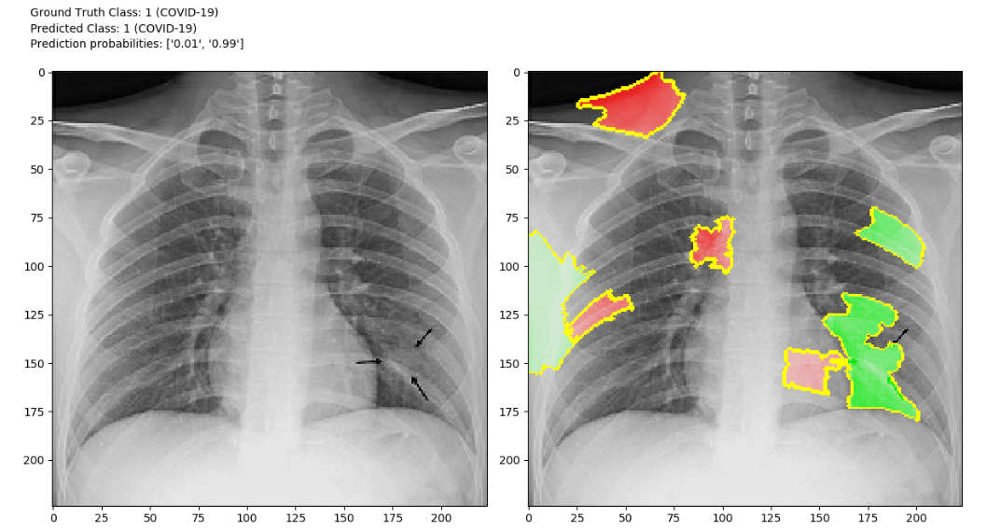
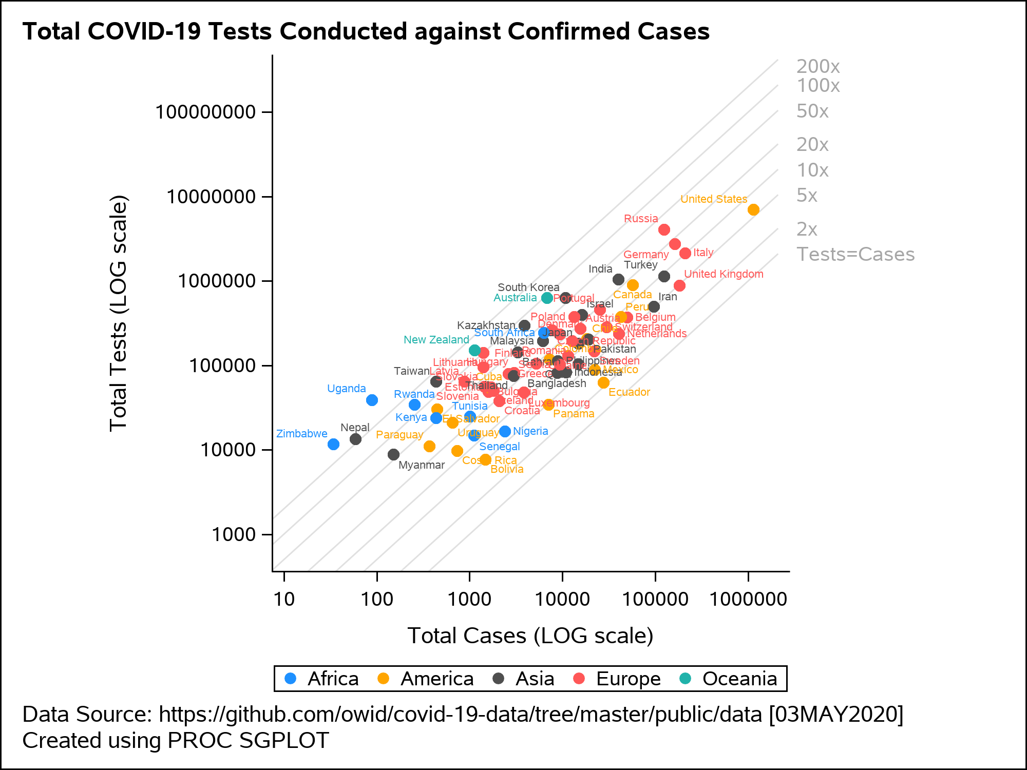
Pattern Recognition Applications
Understanding Disease

Slide 11
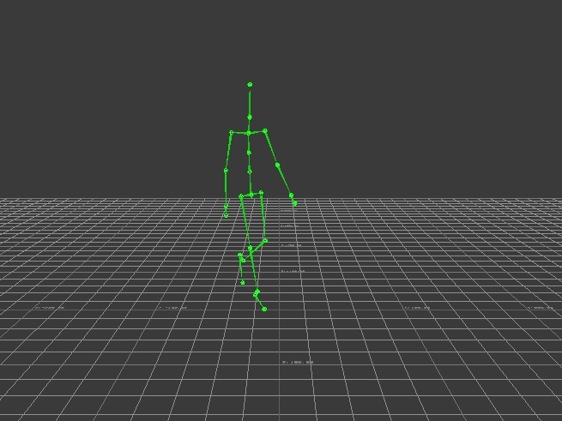
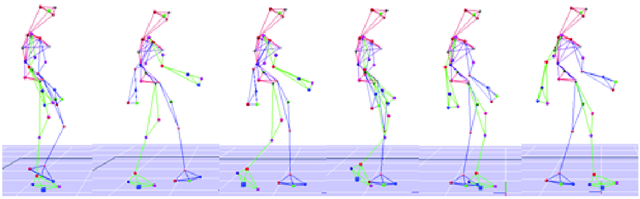
Pattern Recognition Applications
Understanding Human Behaviour

Slide 12


Pattern Recognition Applications
Understanding Financial Markets

Slide 13
This course
5 week Introduction of some key, useful PR analytical techniques
Previously (before I joined Imperial), the PR component of this course was also applied to CV
Instead, I approach the course in a non-CV specific manner
This is also to expose you to different types of data

Slide 14
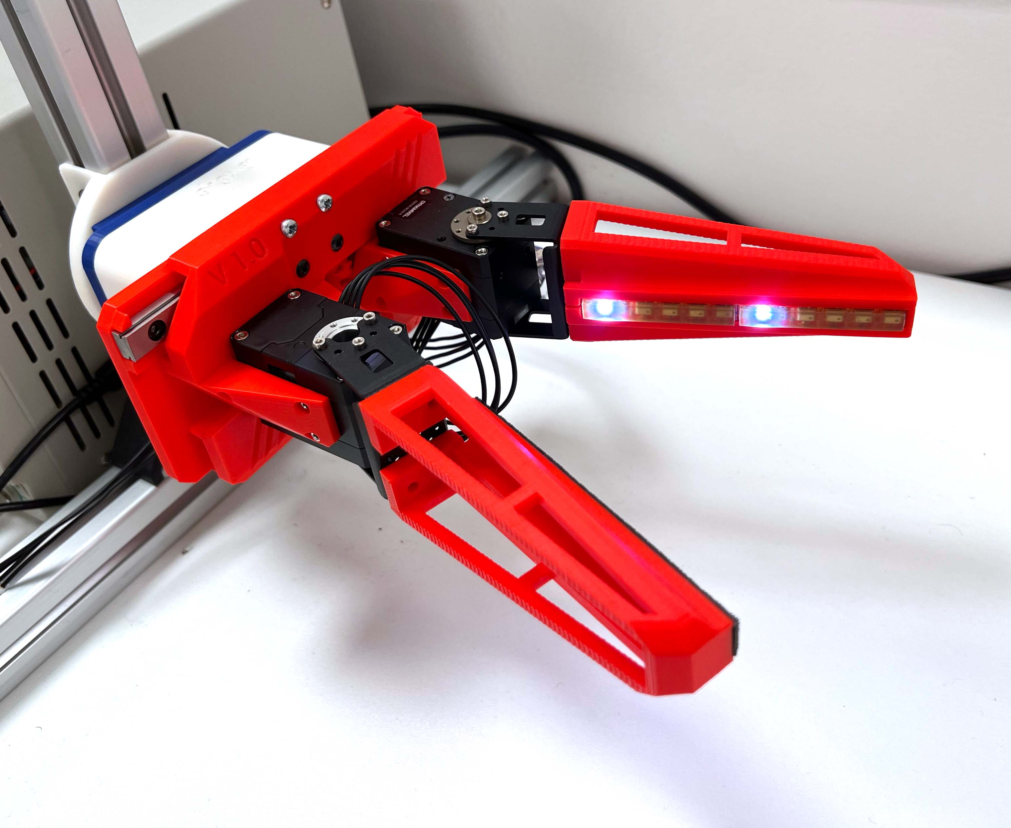

This Course
We’ll be considering non-visual data
As may be used in robotics and human motion capture / analysis
These topics reflects my own research interests and expertise
www.imperial.ac.uk/people/a.spiers
www.imperial.ac.uk/manipulation-touch
Assessment will be by coursework
To be discussed at the end of this lecture

Slide 15
Dimensionality Reduction

Slide 16
Dimensionality Reduction
As engineers, scientists and analysts, we often find ourselves trying to understand data that exists in many dimensions
i.e. There are many variables involved
Let’s say we have built some new interactive technology
We are trying to work out how effective it is via human trials
Let’s say our technology is an exoskeleton designed to help people carry heavy weights

Slide 17
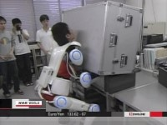
Exoskeleton Example
https://www.cyberdyne.jp/english/products/HAL/

Slide 18
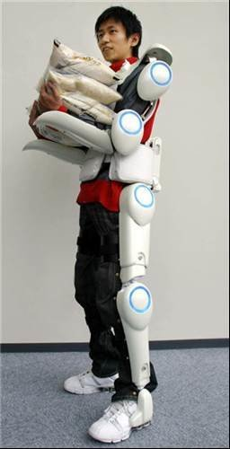
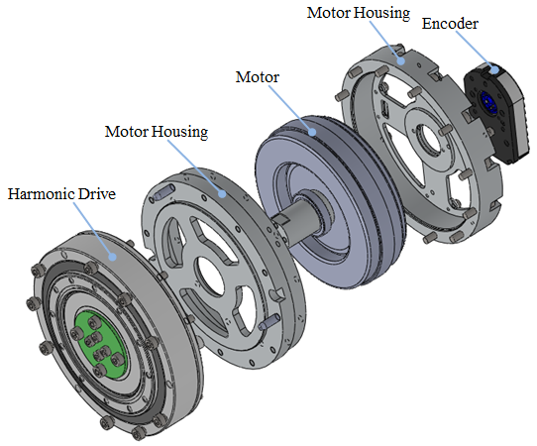
Example
We want to see how well the exoskeleton actuators cope with different users, who may move at different speeds
So, we measure the torque and acceleration at each actuator during carrying experiments with 12 people.
HAL Exoskeleton

Slide 19
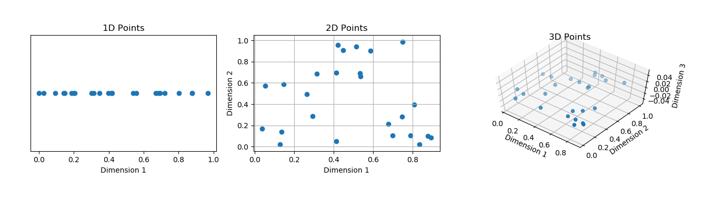
Example
Let’s look at the data for one actuator
Say, a shoulder actuator
There are 2 variables
It is easy to plot this on an XY scatter plot and look for trends
Participant | Shoulder Flex Torque (Nm) | Shoulder Flex Accel (rad/s²)
P1 | 5 | 1
P2 | 4.8 | 0.9
… | … | …
P12 | 4 | 0.8

Slide 20
Example
However, if we want to look at the shoulder and elbow together, we end up with 4D data
We can only plot data up to 3D, so what do we do?
What if we want to analyse all the joints?
We’ll get 16-Dimensional data
Participant | Shoulder Flex Torque | Shoulder Flex Acceleration | Elbow Flex Torque | Elbow Flex Acceleration
P1 | 5 | 1 | 3 | 1
P2 | 4.8 | 0.9 | 3.6 | 0.8
… |  | … | … | …
PN | 4 | 0.8 | 2.9 | 0.5

Slide 21
Dimensionality Reduction
To visualise the data (and increase interpretability) we need to
Reduce Data Dimensions (to 3D or less)
- and -
Preserve Data Structure (the relationships between observations)

Slide 22
Dimensionality
Some problems can contain tens or hundreds of features
It is unlikely that each feature is equally useful for discrimination / categorisation
Classification accuracy is often not directly proportional to dimensionality
So we could get very similar (or even the same) classification results with less lower dimensions.
Lower dimensionality also reduces computational demands and makes it possible to visualise the data

Slide 23

‘The Curse Of Dimensionality’
Highly Dimensional
As dimensions increases, volume of space also increases
Datapoints becomes sparse (further from each other)
To achieve statistical significance with techniques we require similarity and density
Techniques in PR and ML start to break down (e.g. K-NN, which we’ll cover later)

Slide 24
‘The Curse Of Dimensionality’
As dimensions increases, volume of space also increases
Datapoints becomes sparse (further from each other)
To achieve statistical significance with techniques we require similarity and density
Techniques in PR and ML start to break down (e.g. K-NN, which we’ll cover later)

Slide 25
Next
Let’s look at a popular linear dimensionality reduction technique…

Slide 26
Principle Component Analysis (PCA)

Slide 27
Principle Component Analysis (PCA)
PCA is a technique for dimensionality reduction, lossy data compression, feature extraction, and data visualisation.
It is also known as Karhunen-Loeve (KL) transform
PCA is defined as the orthogonal projection of the data onto a lower dimensional linear space such that the variance of the projected data is maximised.

Slide 28
Principle Component Analysis (PCA)
Original data exists in a number of fixed dimensions (e.g. X, Y, Z)
PCA creates new dimensions that maximise variance between data-points
The dimensions are determined by our current data
This makes PCA adaptive to current conditions
But a pre-computed and ‘fixed’ PCA may not be useful for new data

Slide 29

I like to learn and teach by example
I also really like coffee
So our next example is about coffee / cafes

Slide 30
Some Data
50 points distributed over 2 Dimensions, x & y
The data is a university cafe’s loyalty card records over one month
Each data point is a customer
x = number of snacks purchased
y = number of drinks purchased

Slide 31

Patterns
The café manager wants to understand typical customer behaviour and present this to the café owner
The café owner is currently very busy, and has little time for detailed presentations
So the café manager is going to simplify the data
Note: We should not make assumptions about why a data scientist is managing a café.

Slide 32
Data
We can see that the data has a particular diagonal grouping
This is a pattern of the data
We’d like to create a single dimension for representing the data
Remember – this is an example for class with simulated data. Often, such patterns in real-world data are not obvious to us
Your coursework is on real data ☺

Slide 33
Consider only a single dimension
A simple way of reducing dimensions is to only consider the data in terms of the x or y variable.
We ‘project’ the data points onto the relevant axis
Plotting these as 1D number lines gives:

Slide 34
Consider only a single dimension
But we lose the overall ‘diagonal’ distribution pattern of the data
Instead the results are fragmented
We shouldn’t therefore consider the variables independently

Slide 35
What if…
That diagonal line was an axis of the figure?
Then we could represent the data distribution along that new axis
Instead of being stuck to x or y
This is the idea behind Principle Components
We determine new axes that best represents variance in our data

Slide 36


New Axes = Alternative Dimension(s)!

Slide 37
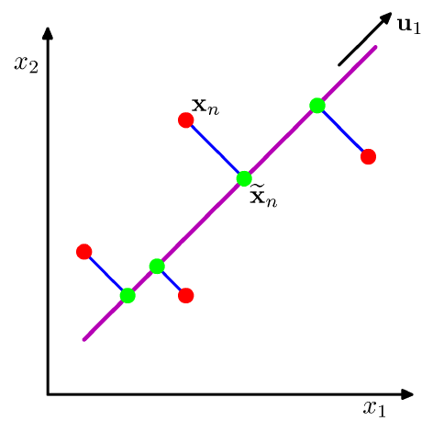
The PCA problem
Given a data set {x_{n}}, n = 1,...,N and x_{n} ∈ R^{D}
We want to project the data onto a space of dimension M<D
While also maximising projected data variance
Let’s say D = 2 and M = 1
So we want to convert 2D data into 1D data
y
x

Slide 38
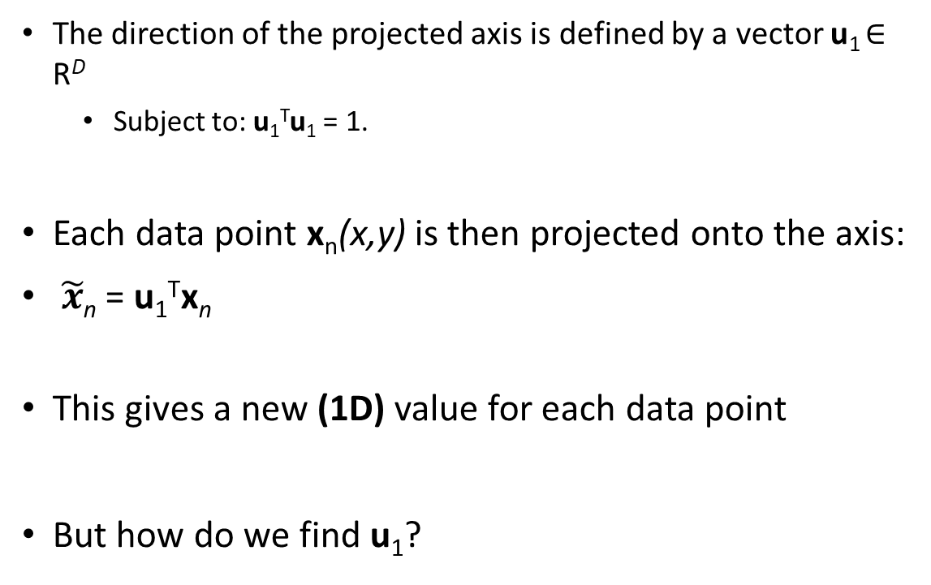
Projection
The direction of the projected axis is defined by a vector u₁ ∈ R^{D}
Subject to: u₁^{T}u₁ = 1.
Each data point x_{n}(x,y) is then projected onto the axis:
$\tilde{x}$_{n} = u₁^{T}x_{n}
This gives a new (1D) value for each data point
But how do we find u₁?
y
x

Slide 39

Finding a Principle Component
u₁ is a principle component
We choose an axis for the principal component that maximises the variance between data points when they are projected onto that axis
This is also equivalent to minimizing the reconstruction error

Slide 40
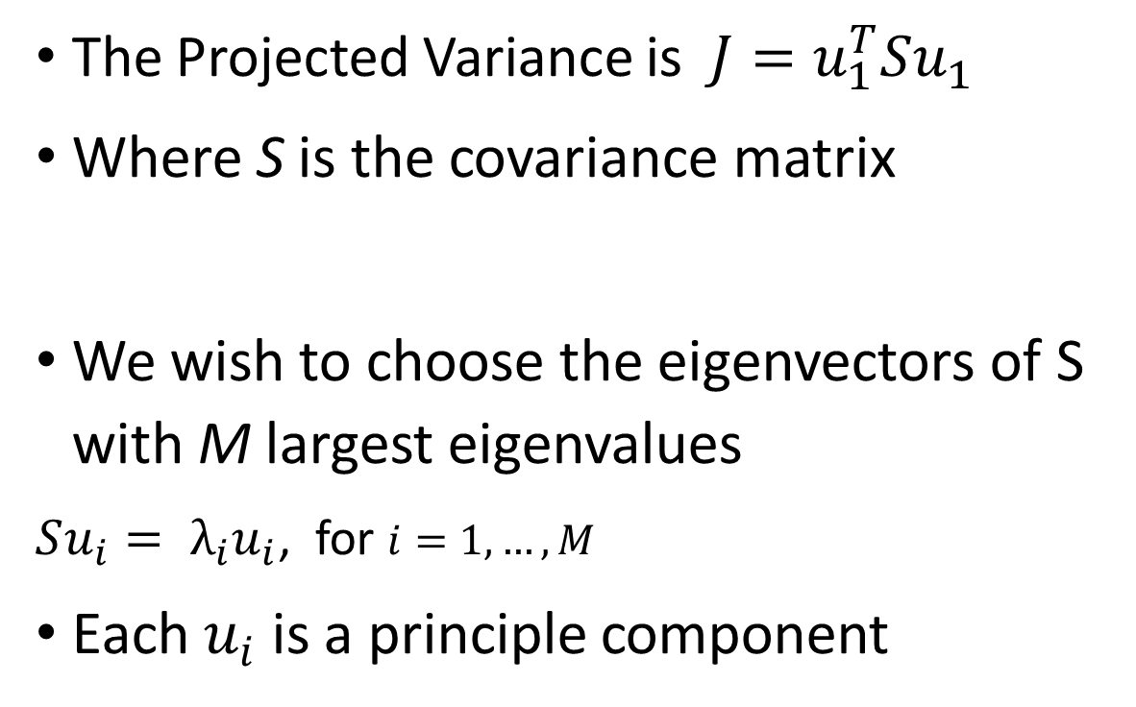
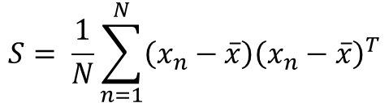
Projection
The Projected Variance is $J=u_{1}^{T}Su_{1}$
Where S is the covariance matrix
We wish to choose the eigenvectors of S with M largest eigenvalues
$Su_{i}= λ_{i}u_{i}$, for $i=1,…,M$
Each $u_{i}$ is a principle component
y
$$S= \frac{1}{N}\sum_{n=1}^{N}{\left(x_{n}−\overline{x}\right){\left(x_{n}−\overline{x}\right)}^{T}}$$
x

Slide 41
PCA Steps
Standardise the Data
Compute the Covariance Matrix
Calculate Eigenvectors and Eigenvalues
Select a Feature Vector
Project Data onto Principle Components

Slide 42
Step 1 – Standardise the data
Removes bias from different variable ranges
Data is now centred on (0,0)
This will also be the origin of the new axes

Slide 43
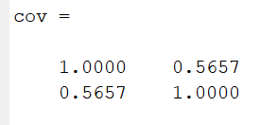
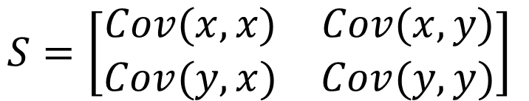
Step 2: Calculate the Covariance Matrix
We wish to understand the relationship between variables
The covariance matrix is an D x D square matrix
if positive then : the two variables increase or decrease together (correlated)
if negative then : One increases when the other decreases (Inversely correlated)
$$S=\left[\begin{matrix}Cov(x,x) & Cov(x,y) \\ Cov(y,x) & Cov(y,y)\end{matrix}\right]$$

Slide 44
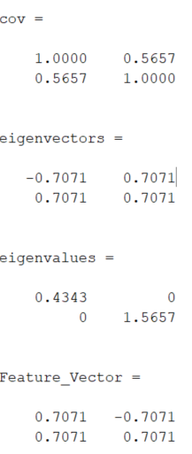
Step 3. Determine Eigenvectors & Eigenvalues
Get the eigenvalues and eigenvectors of the covariance matrix
The eigenvectors may be plotted on the data to show the principle components (PCs)
The eigenvalues show the variance of the corresponding PC
First PC has the highest variance

Slide 45
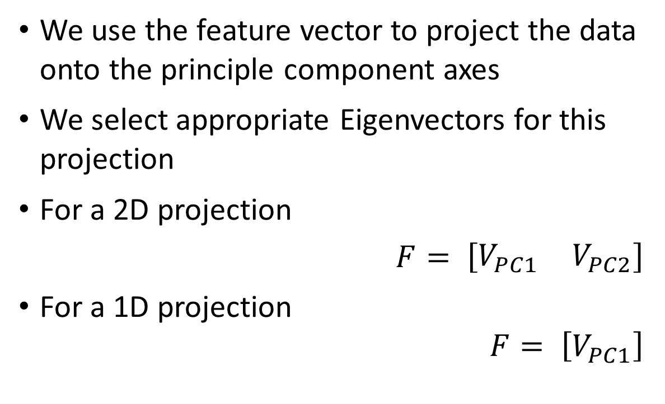
Select Feature Vector
We use the feature vector to project the data onto the principle component axes
We select appropriate Eigenvectors for this projection
For a 2D projection
$$F= \left[\begin{matrix}V_{PC1} & V_{PC2}\end{matrix}\right]$$
For a 1D projection
$$F= \left[V_{PC1}\right]$$

Slide 46
Projection onto Principle Components
$$\tilde{x}\text{n}\text{ = }\text{u}\text{1}\text{T}\text{x}\text{n}$$

Slide 47
Projection onto PCs
We can also visualise this via 1D plots
PC1 on its own would be a 1D representation of the original 2D data

Slide 48
Compare (x,y) to (PC1, PC2)
Data is now ordered by variance
We see the greatest variation in data in PC1
Followed by PC2
In higher dimensional data this order would continue
We could then select the first few PCs to represent our data

Slide 49
More on Principle Components
The new axes are not related to a tangible quantity
We cannot say the units are ‘drink/snacks’
The axes may not even an equal ratio of drinks to snacks.
Though our example deals with quantities of items, the principle components could also exist between completely different units
E.g. Mass / Cost

Slide 50
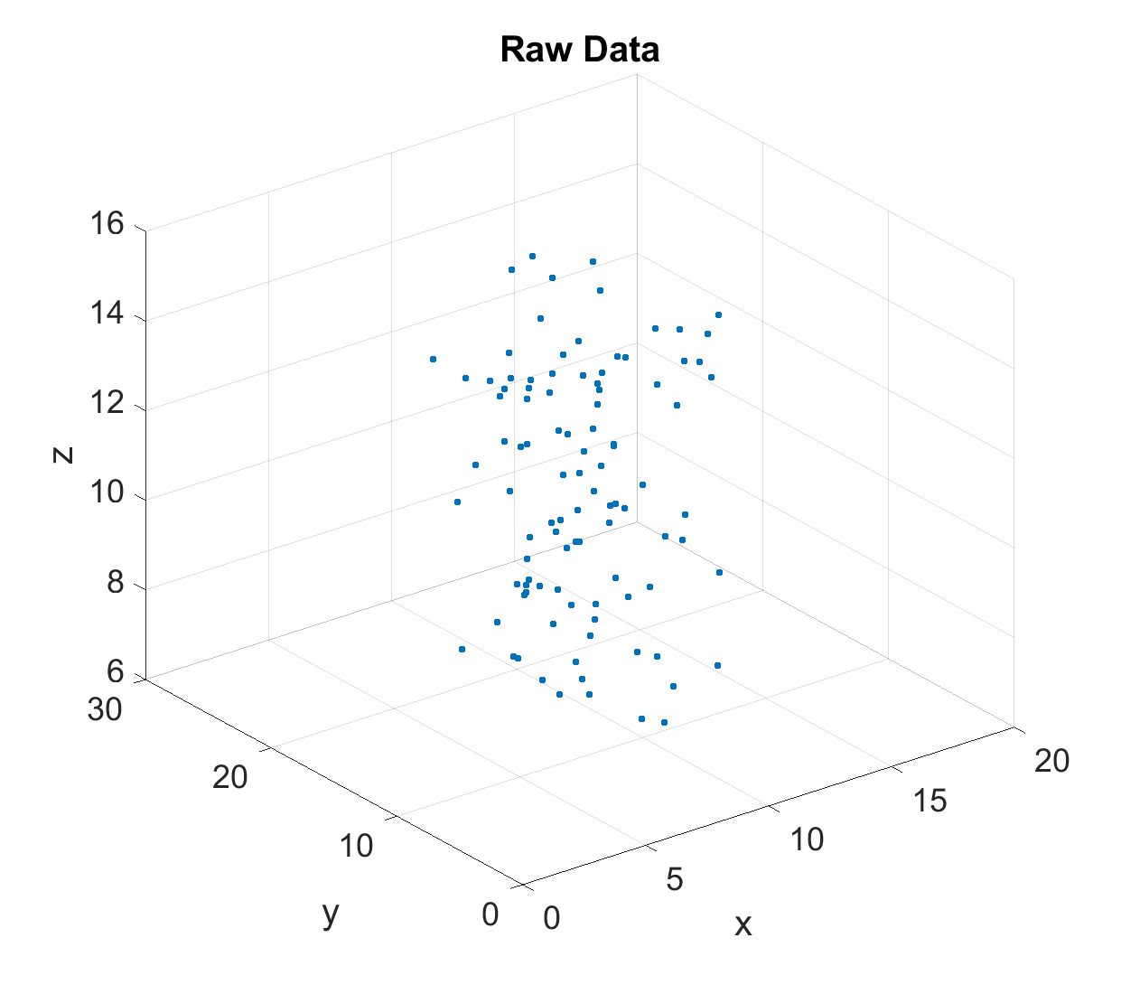
More interesting
3D example
Let’s include time of first item purchase (z)
Café is open 7am to 4pm
Ignore the 6am in the plot, that is just Matlab scaling.
The lowest value is 7

Slide 51
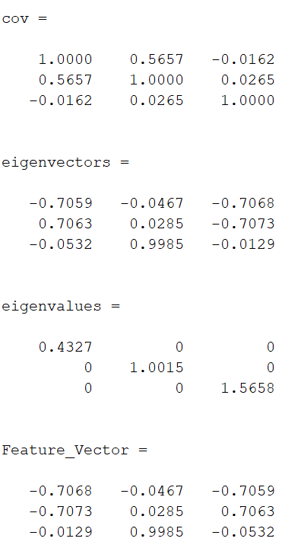
Calculations
Now a 3x3 matrix
Eigenvalues gives variance of PCs
Eigenvectors give directions of PCs

Slide 52
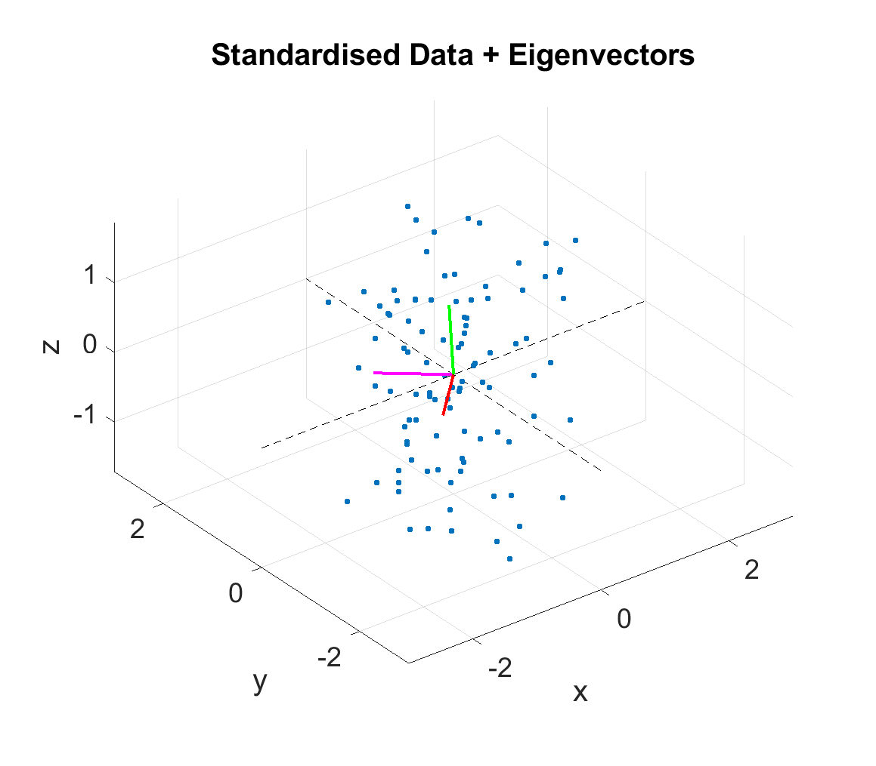
Plotting the PCs

Slide 53
Data Variance in PCs

Slide 54
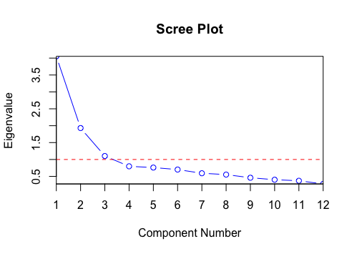
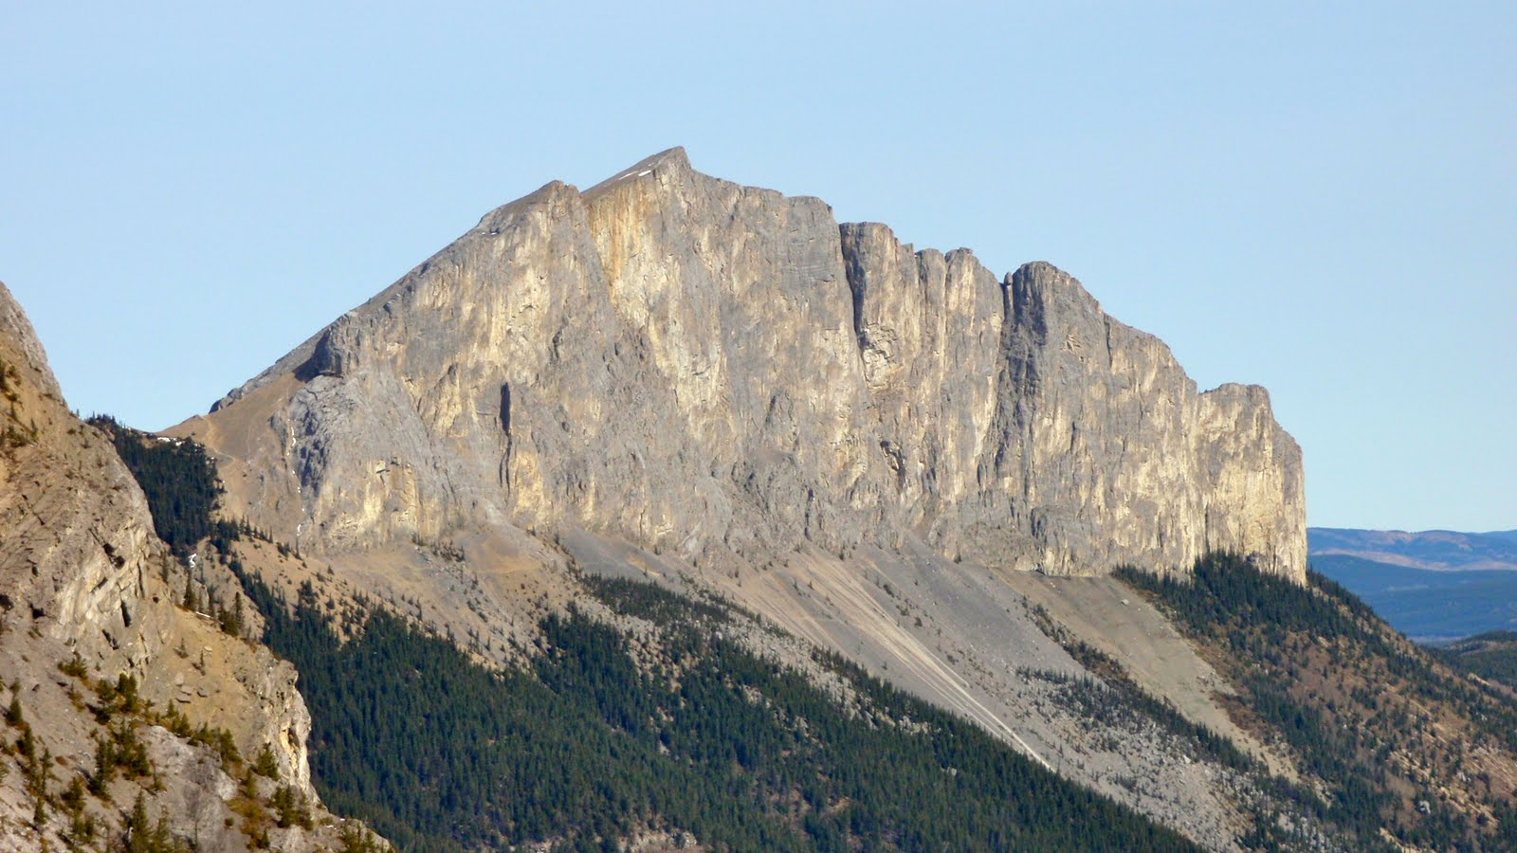
Scree Plots
Show how variance is distributed across the Principle Components
Generally an exponential decay
Can be used to subjectively find an ‘elbow’ in the data which enables us to choose number of PCs
Scree is the collection of small rocky fragments that fall off a mountain
These also cause an elbow in topography

Slide 55
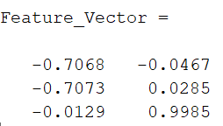
Construct Feature Vector
Let’s say we just want to view the data in 2D
Our feature vector is constructed from the columns of the relevant eigenvectors

Slide 56
Reduce to 2D
Standardised Data * Feature Vector

Slide 57
Visualise Variance
Patterns emerge if we project all of our data (via a complete Feature Vector)
We can see some potential for discriminating and clustering the data
Hold that thought until next week…

